Slide 1


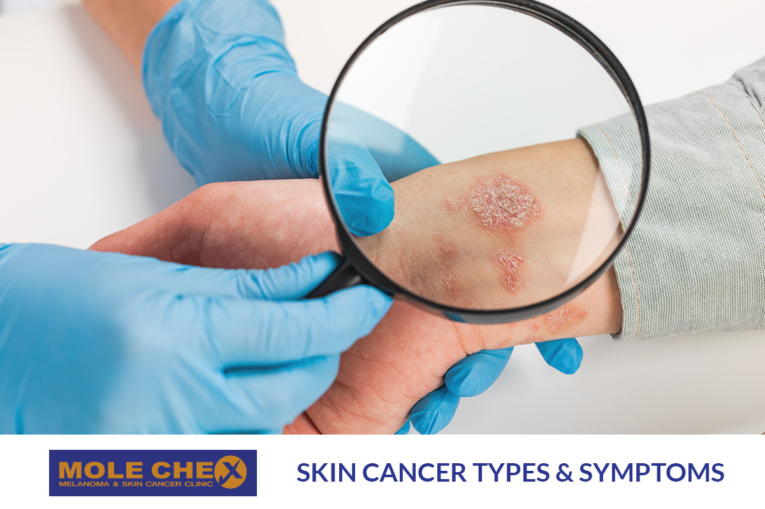
Skin Lesion Classification Using Deep Learning
An Application of CNN for Multi-class Skin Disease Prediction

Slide 2

About Skin Lesions
What is a Skin Lesion ?
A skin lesion is any abnormal change or growth on the skin, such as moles, sores, or discolorations. Lesions are categorized into benign (non-cancerous) or malignant (cancerous) types.
Causes of Skin Lesions :
-UV Radiation: Sun or tanning bed exposure damages skin cells, increasing cancer risk.
-Genetics: Family history raises the risk of skin lesions, especially cancer.
-Inflammation/Infections: Conditions like acne or eczema cause lesions through ongoing irritation.

Slide 3
Project Overview
The Problem :
Accurately diagnosing skin cancer is challenging due to the need to distinguish between various types of lesions. Misdiagnosis can lead to treatment delays and negatively impact patient outcomes.
Why We Choose This Project :
We chose this project to assist doctors in quickly and accurately diagnosing skin lesions.

Slide 4
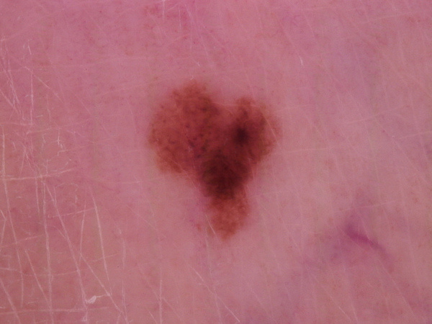
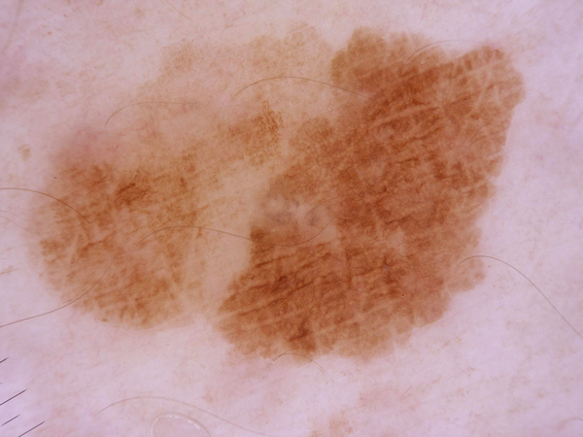
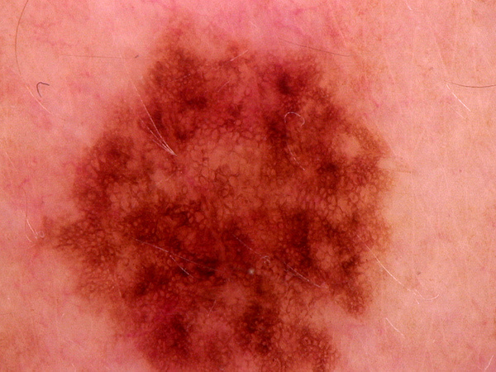
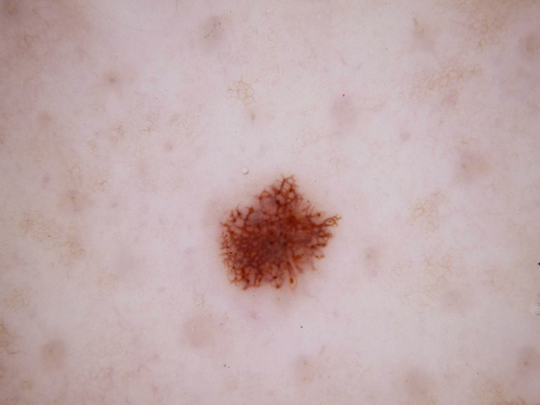
Dataset Overview: Skin Cancer MNIST: HAM10000
HAM10000: Human Against Machine with 10,000 Dermatoscopic Images.
The dataset consists of images and associated with csv text file . We use these modalities together in a multi-class classification model .
The dataset contains the following columns:
-lesion_id : A unique identifier for each lesion.
-image_id : The corresponding ID for each image in the dataset.
-dx : The diagnosis label for the lesion (e.g., bkl, nv, mel, etc.).
-dx_type : The method used to confirm the diagnosis (e.g.,histopathology, follow-up).
-age : The age of the patient.
-sex : The gender of the patient (male or female).
-localization : The anatomical location of the lesion on the body (e.g., scalp, back, etc.).

Slide 5
Dataset Overview: Skin Cancer MNIST: HAM10000
The dataset contains labeled skin lesion images for 7 different classes :
-bkl (Benign Keratosis-like lesions)
-nv (Melanocytic Nevi)
-df (Dermatofibroma)
-mel (Melanoma)
-vasc (Vascular Lesions)
-bcc (Basal Cell Carcinoma)
-akiec (Actinic Keratoses and Intraepithelial Carcinoma)

Slide 6
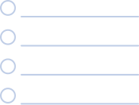
Essential Phases of the Workflow
Visualization
PreProcessing
Model Architecture
Evaluation

Slide 7

Visualization

Slide 8
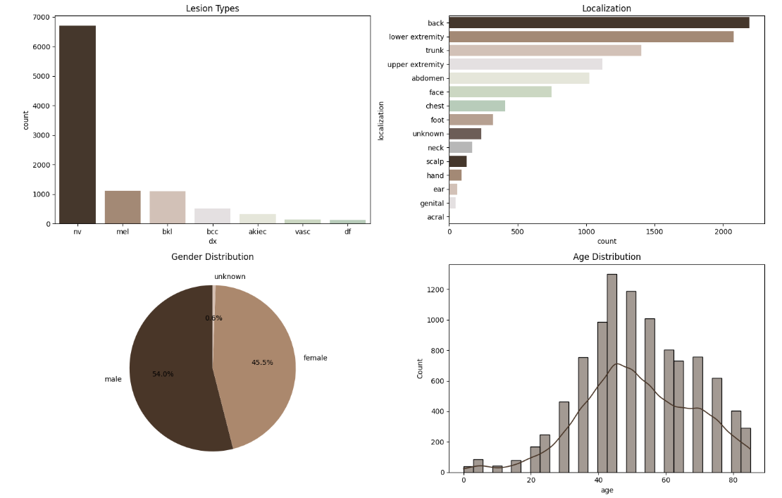
visualization of data
At first ,We visualized relationships representing the distribution of various dataset features, such as :
lesion types count using bar chart .
lesion locations count using horizontal bar chart .
gender count using pie chart .
age distribution using histogram and density curve .

Slide 9
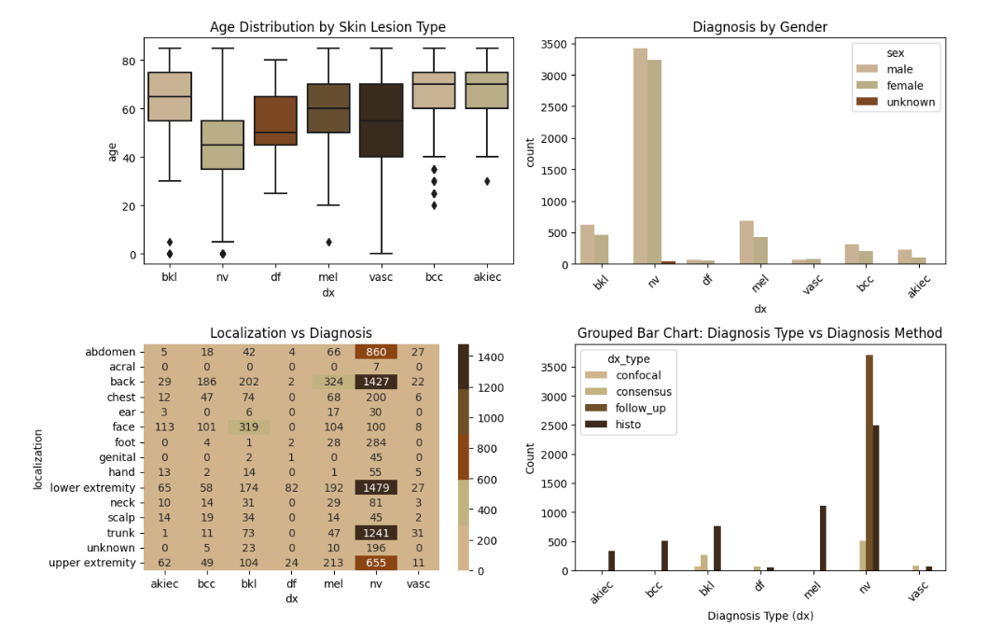
Next, we explored relationships between various features to uncover patterns, such as:
how age varies across lesion types using poxplot
gender distribution for each diagnosis using countplot
lesion localization trends using
heatmap .
the diagnostic methods used for each
lesion type using grouped bar chart.

Slide 10

After visualization for image and text data
we know that
Data is imbalanced
Find null value
Find unnecessary column
Find categorical columns
these all will solved in preprocessing stage

Slide 11
Preprocessing

Slide 12
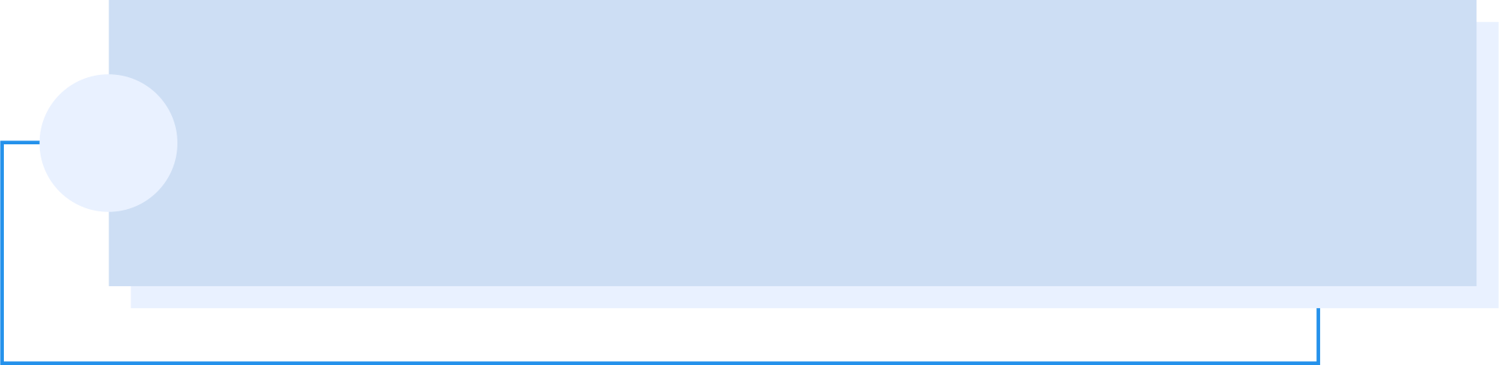
Preprocess on images data
Preprocess on text data

Slide 13
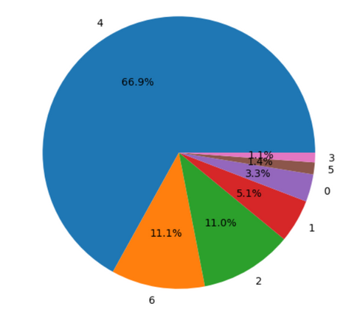
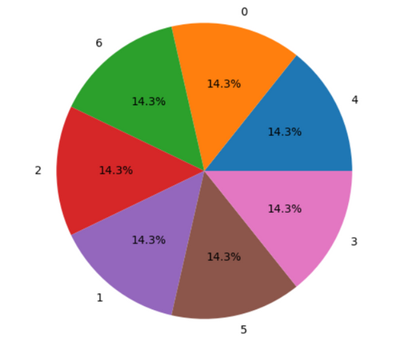

Preprocessing on images:
Normalization
scaling data to a specific range [0, 1], to improve model performance by ensuring consistent feature magnitudes.
Augmentation
to solve Imbalanced image data problem

Slide 14


Preprocessing on Table
Drop Unnecessary Columns
Handel category columns
Handel Imbalance
Handel Missing value
scale

Slide 15
Model

Slide 16

Model Architecture
Model on images:
A Convolutional Neural Network (CNN) is used to classify skin lesions into 7 categories. The model includes:
- Input Shape: (28, 28, 3).
- Convolutional Blocks: Three blocks with increasing filters (32, 64), ReLU activation, MaxPooling, and
Dropout for regularization.
Fully Connected Layers: Two dense layers (64, 128 units) and ReLU activation.
Model on Table :
- input shape: (4,).
Fully connected layer (16) with ReLU activatioin .

Slide 17
Model Architecture
Combine two models:
Combine two models and enter them to another fully connected layers.
5 Fully connected layers (128 , 64 ,32 , 16 ,7) with ReLU and SoftMax activation for classification output.
Model training :
Loss Function: Sparse Categorical Crossentropy.
Optimizer: Adam
Callbacks: EarlyStopping, ModelCheckpoint, and ReduceLROnPlateau for efficient training.

Slide 18
Evaluation

Slide 19
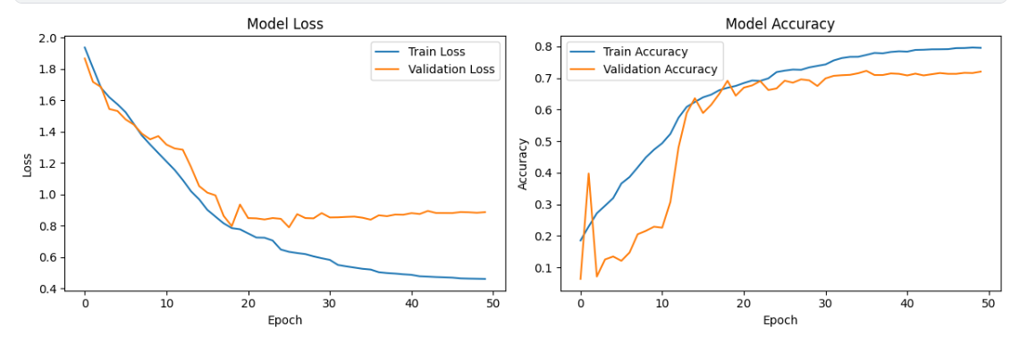
Model Performance Analysis
Both Training Accuracy and Validation Accuracy improve over time, demonstrating that the model captures
meaningful features from the data.
Validation Accuracy stabilizes at a satisfactory level, showing the model's ability to generalize well to unseen data.

Slide 20
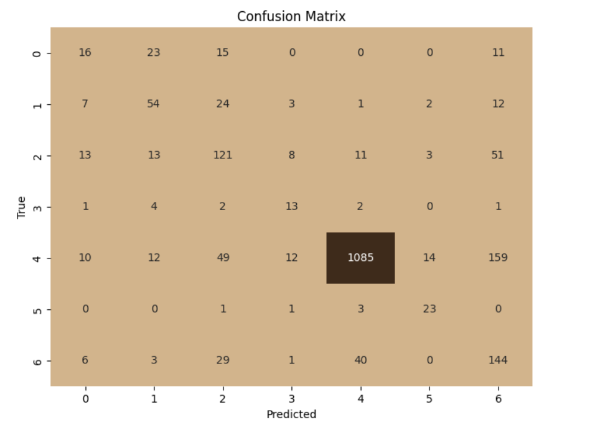
Model Performance Analysis : Confusion Matrix
The diagonal values in the confusion matrix represent the number of correct predictions for each class.
A large proportion of predictions fall along the diagonal, showing that the model performs well in classifying most categories correctly.

Slide 21
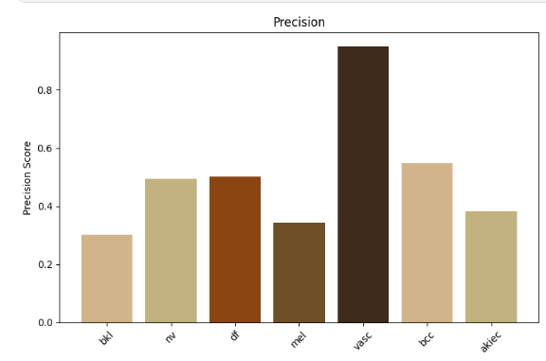
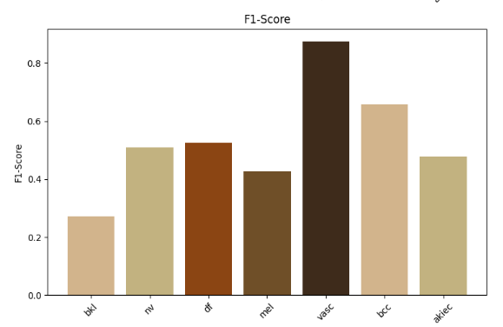
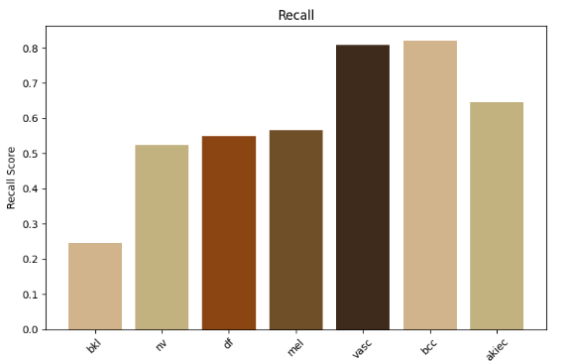
Model Performance Analysis : another metrics

Slide 22



Deployment

Slide 23
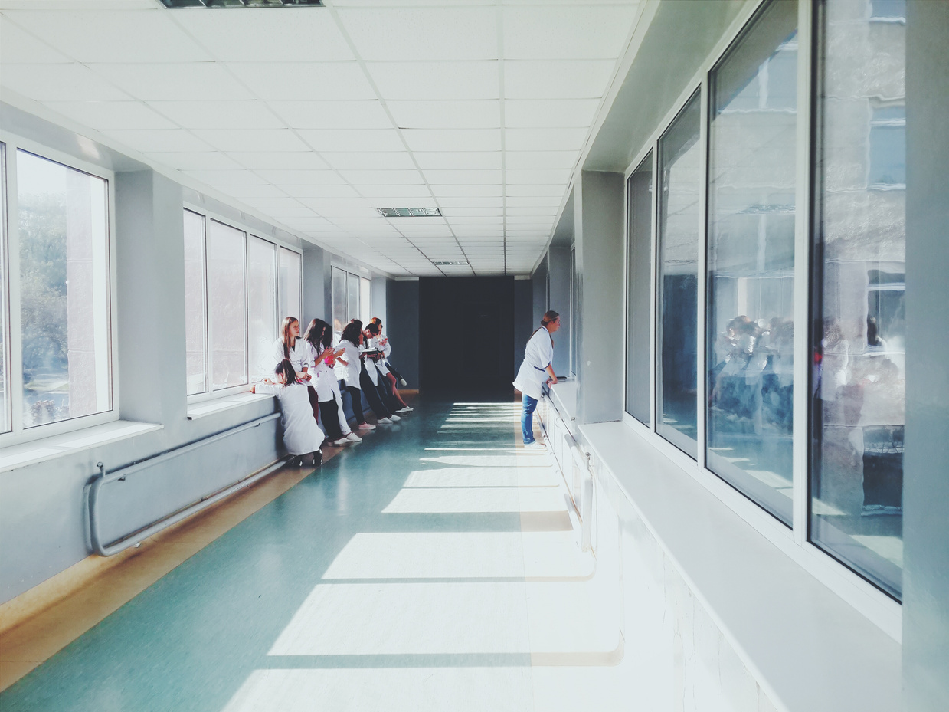
Older adults tend to have declined vision or eyesight
An eye exam can identify the signs of cataracts and glaucoma
Sometimes hearing tests may decide whether senior citizens need to wear hearing aids or not
Eye & Hearing Test

Slide 24
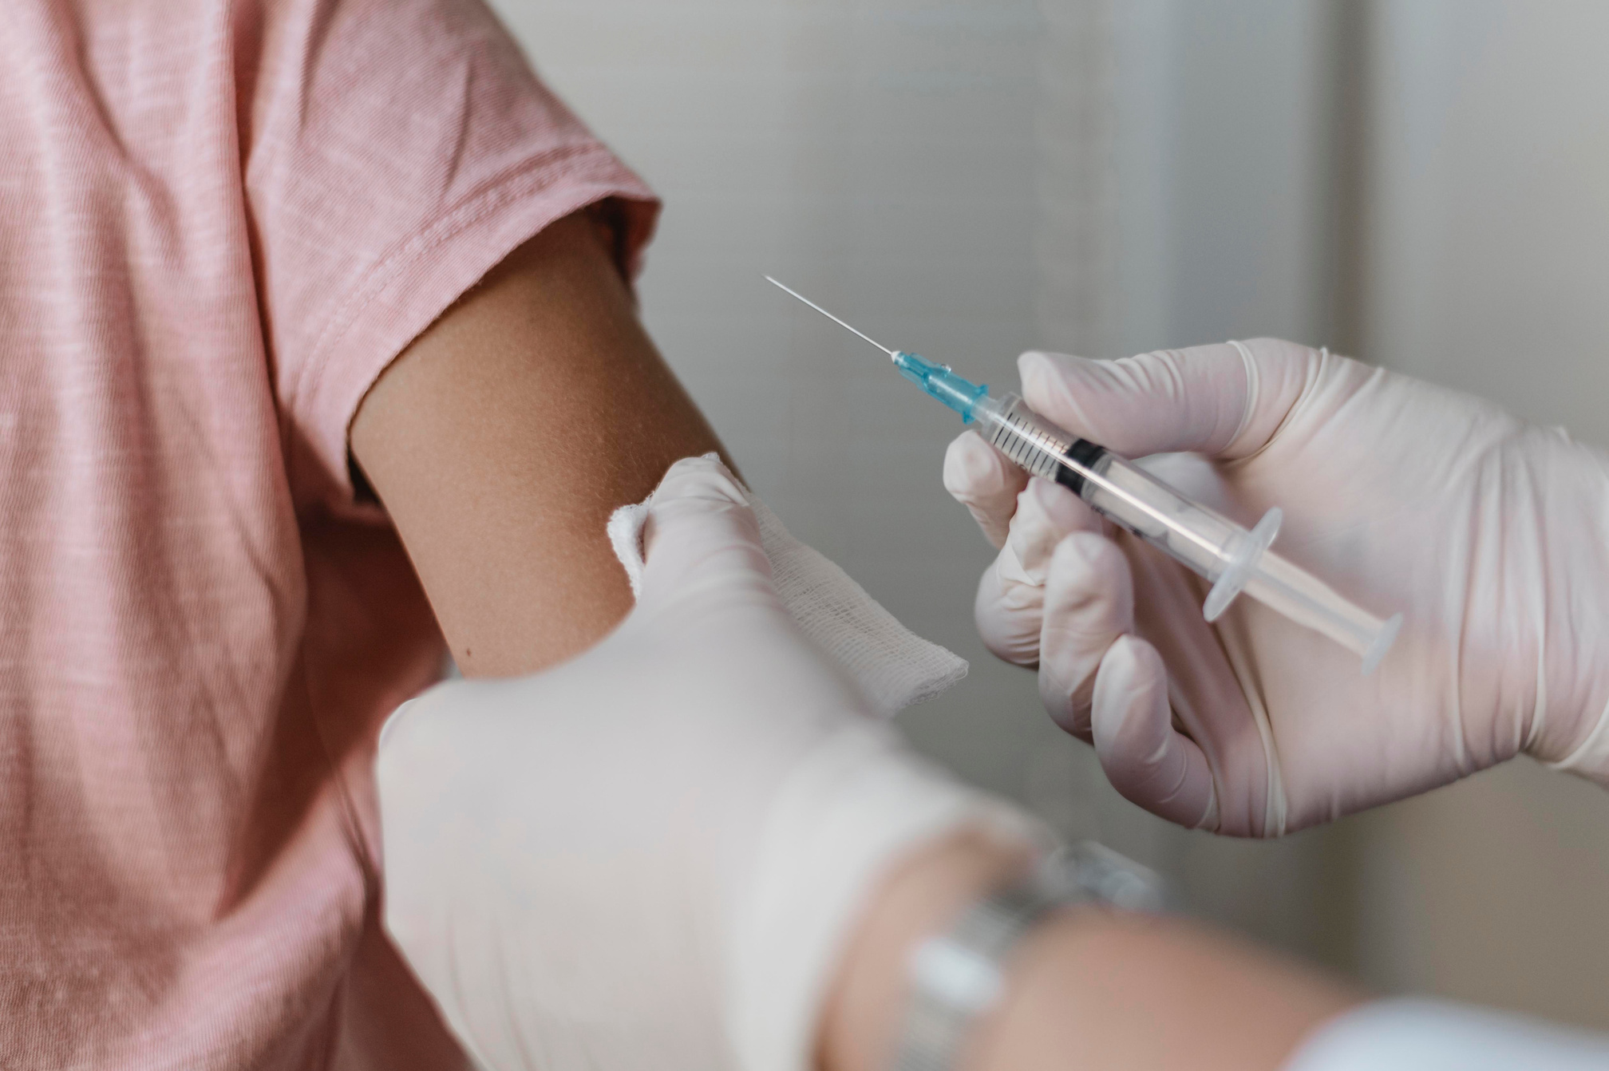
Vaccinations
Flu Shot
The recent COVID-19 vaccines
Shingles vaccine
Pneumonia vaccine
Meningitis vaccine

Slide 25
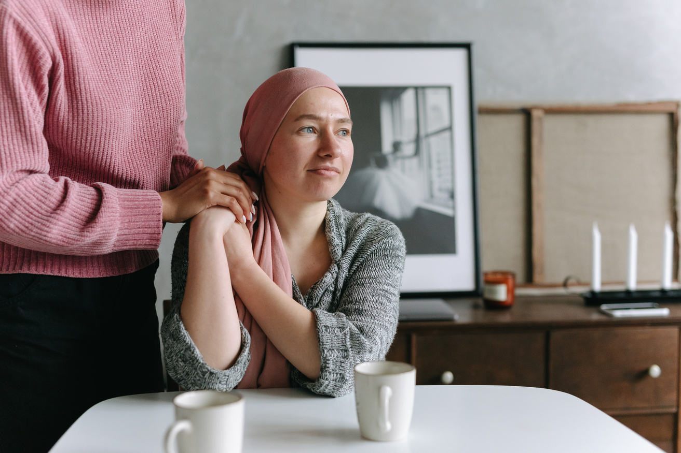
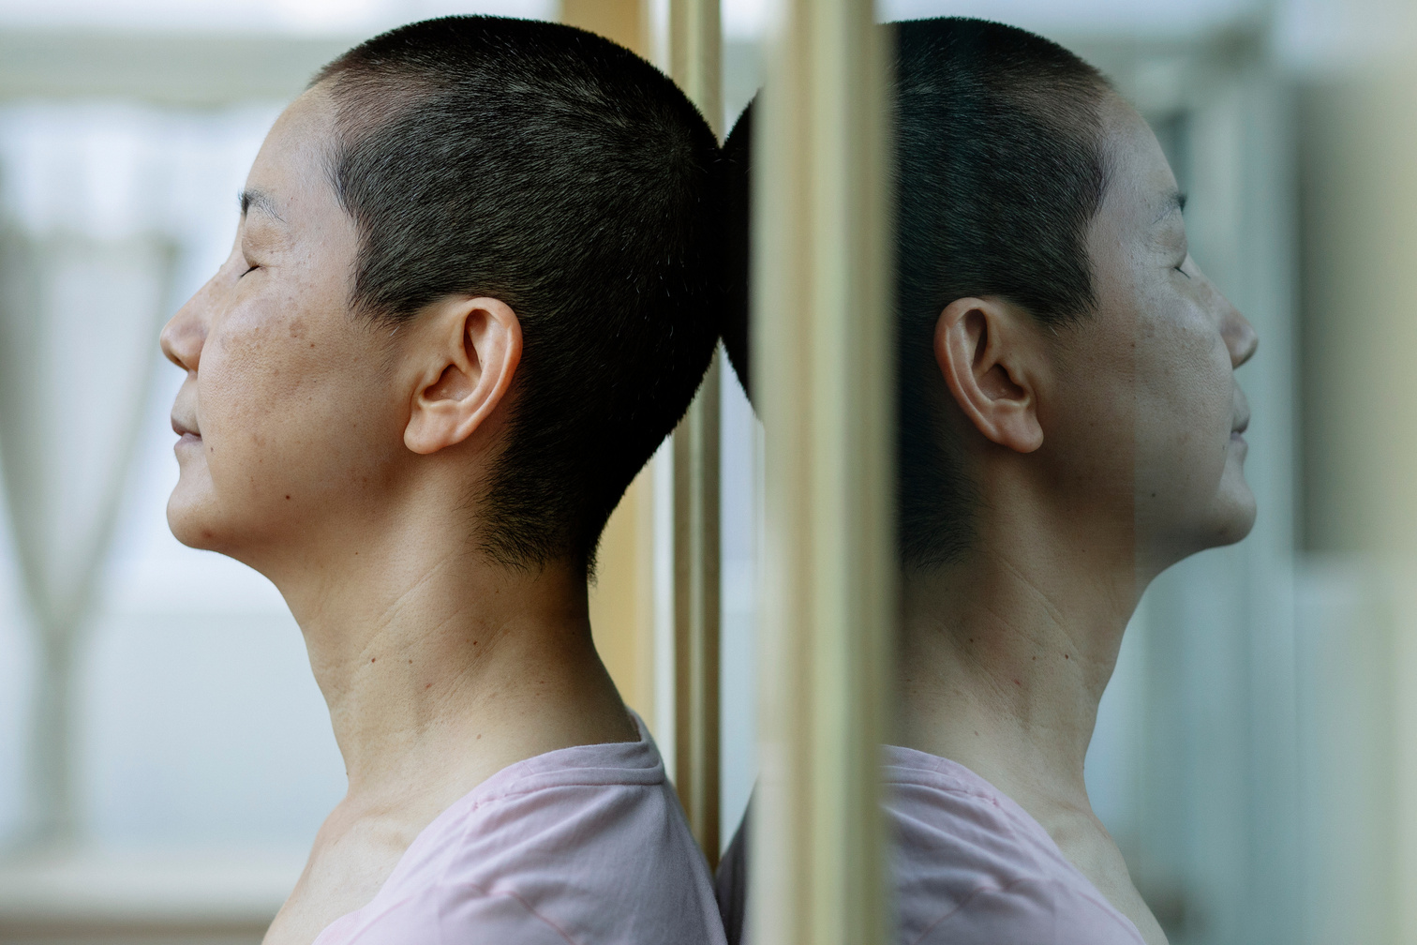

Cancer Screenings
Prostate Cancer
Breast Cancer
Colon (Rectal) Cancer

Slide 26
01.
02.
Senior citizens need to go through essential health and medical screenings regularly, at least for a preventive action
Routine medical screenings may detect any causal health problems earlier, helping the older adults to get the appropriate care or treatment before their conditions get worse
Conclusion

Slide 27
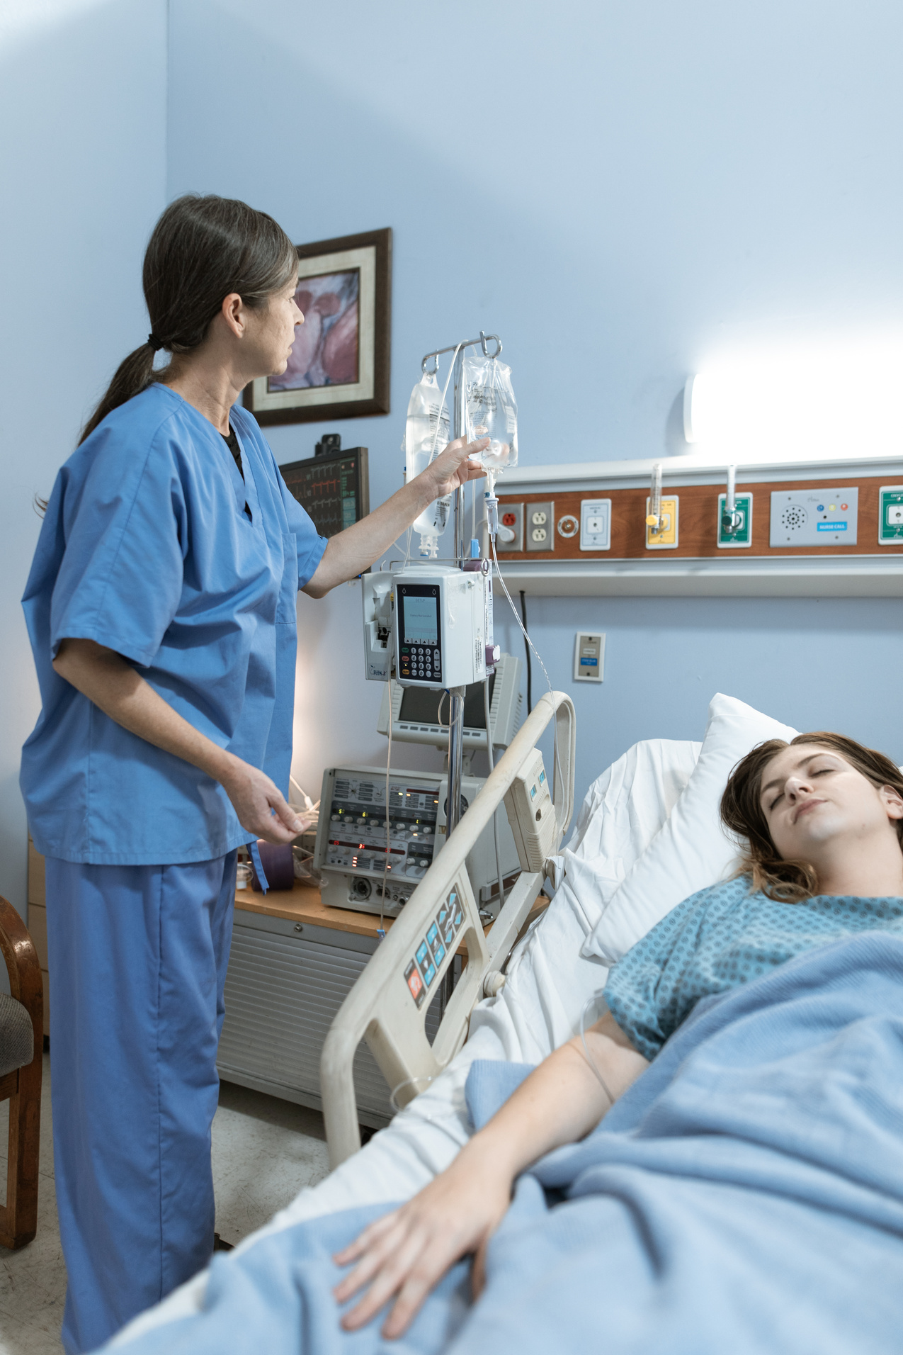
Salford Senior Services
Fauget Western Senior Center
Fauget Northern Senior Center
Fauget Southwestern Senior Center
123 Anywhere St., Any City, ST 12345 | 123-456-7890
123 Anywhere St., Any City, ST 12345 | 123-456-7890
123 Anywhere St., Any City, ST 12345 | 123-456-7890

Slide 28
Running

Slide 29
Go to the Repo via this link: https://github.com/SalmaElgezawy/Skin_Cancer_classification
01. Download ZIP
02. Using Git
From the Code button: press Download ZIP.
Unzip the file.
run the requirement.txt to ensure the required libraries is installed.
Run the code
git clone https://github.com/SalmaElgezawy/Skin_Cancer_classification.git
cd repository directory
pip install -r requirements.txt python main.py
Runthe code

Slide 30

THANK YOU
hello@reallygreatsite.com
www.reallygreatsite.com

